Slide 1
Adventure Works 2019
Interim Project Presentation
Group 2

Slide 2




Meet
the
Team
Lucia Martinez
Hasan
Naimul
Chiedozie Ezeogu
Piotr
Zaprawa
London, 12/02/2026

Slide 3
Introduction & Tools:
Snowflake Database
71 tables, 20 views
SQL (SSMS)
Python → Pandas, Numpy, Matplotlib (Pyplot package)

Slide 4
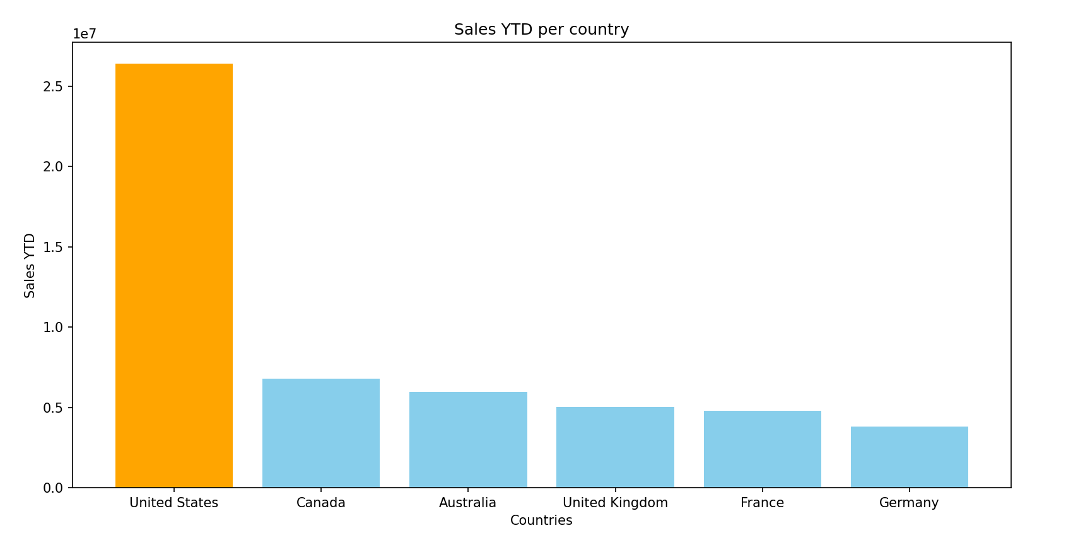
Revenue categorised by Country
Our database compares 6 countries
Best performing country: US
Lowest revenue: Germany

Slide 5
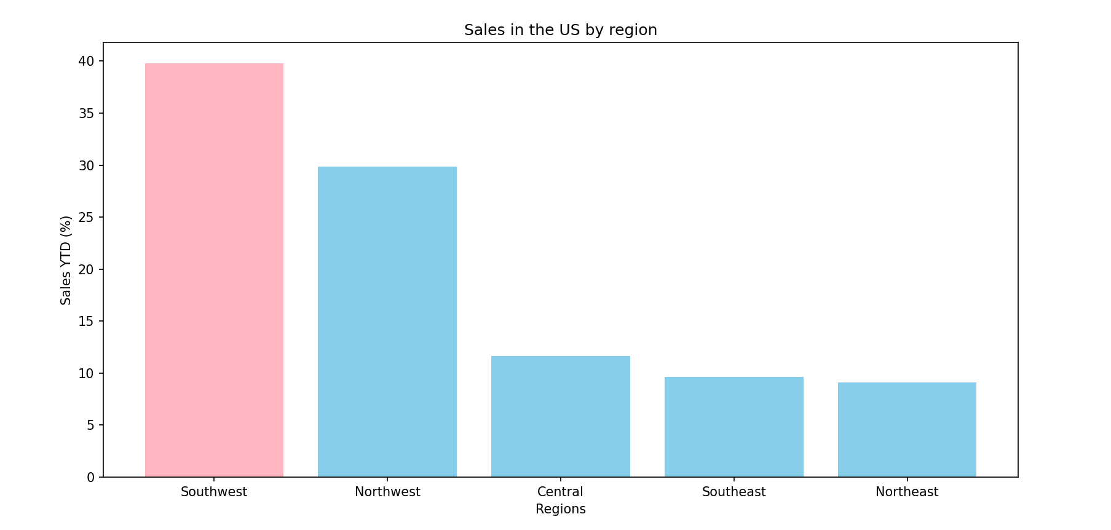
Regional sales in the US (%)
Best performing region: Southwest → almost 40%
Lowest regional sales: Northeast → 9%

Slide 6
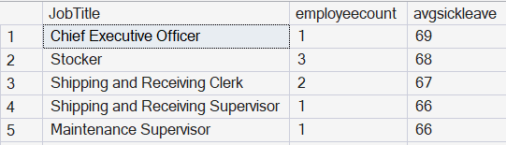
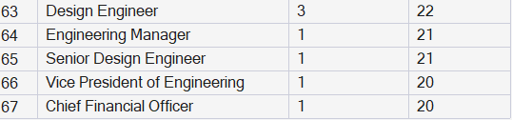
Sick leave accrued categorised by Job Title
Top 5 vs lowest 5
→ Accrued sick leave does not depend on seniority

Slide 7
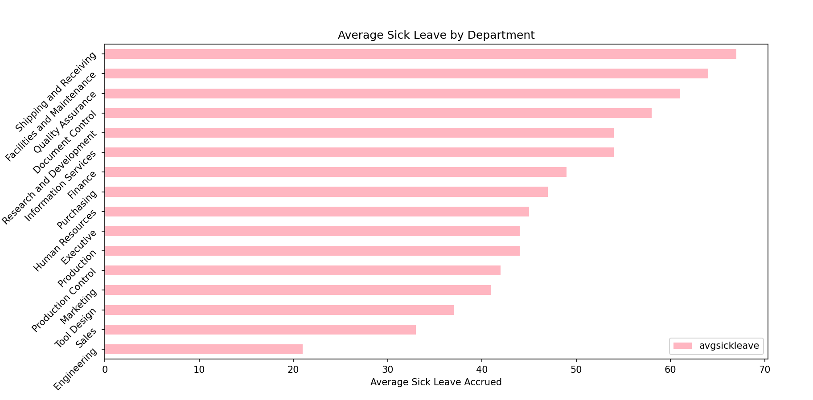
Average Sick leave accrued categorised by department
Engineering is lowest → 21
Shipping and receiving is highest → 67

Slide 8
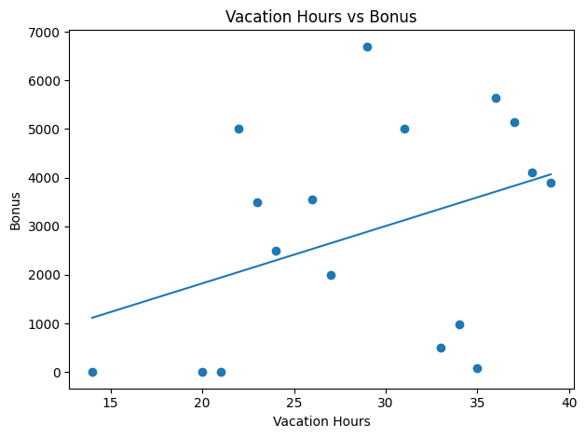
Annual leave vs bonus
Weak correlation
Vacation entitlement independent of bonus
Vacation hours reflect entitlement

Slide 9
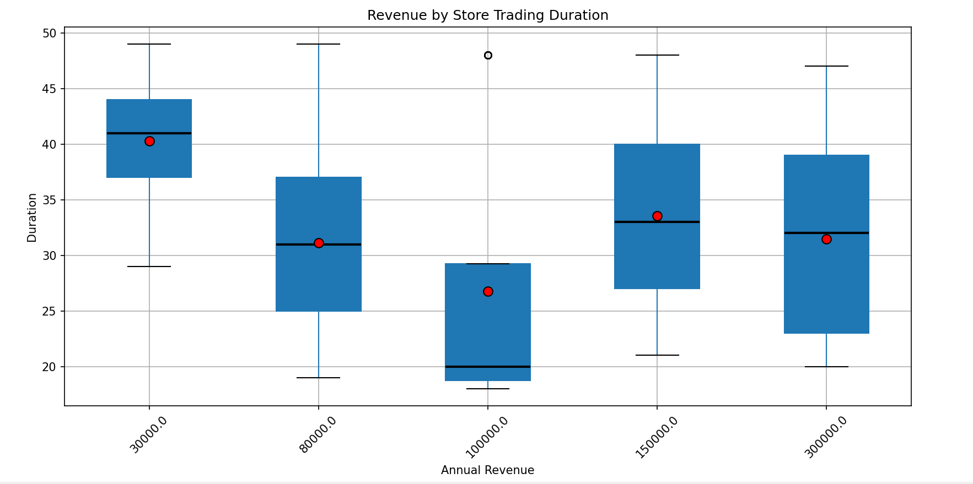
Store trading duration vs yearly customer income (revenue)
Duration does not mean higher income
Between 30k and 100k income → decrease in duration
Do older shops make more money?

Slide 10
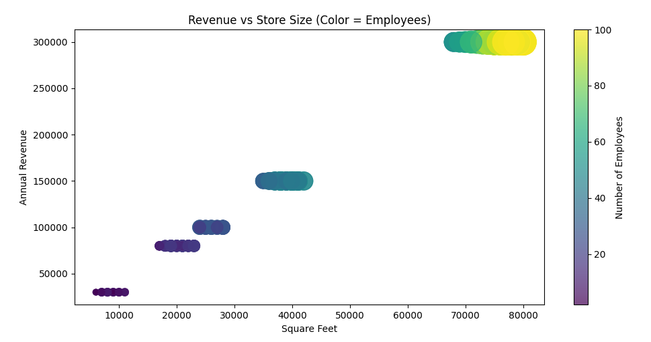
Store size vs number of employees vs customer income (revenue)
Store size vs income → positive correlation
Number of staff vs income → positive correlation
Stores with similar setups outperform each other

Slide 11
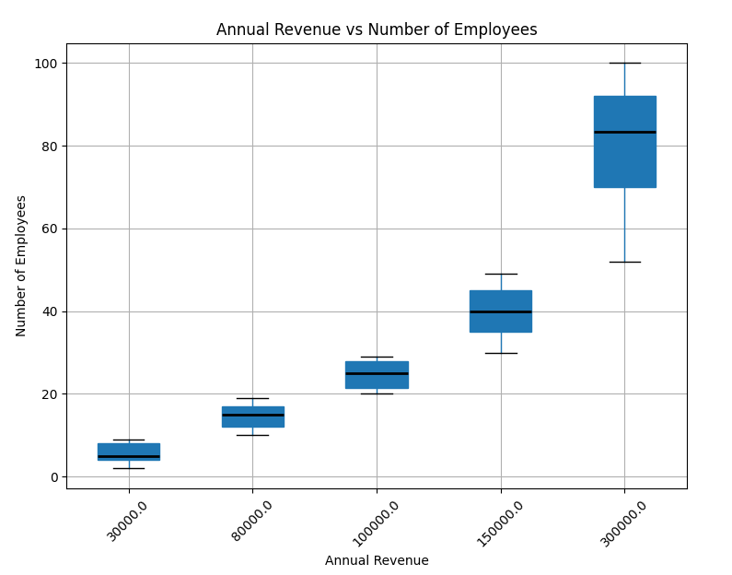
Number of employees vs customer income (revenue)
High achievers → prime store locations, efficient management, experienced staff.
Low achievers: little staff training, not optimal locations.

Slide 12

Conclusions:
US Southwest: highest revenue
Seniority-sick leave → no correlation
Vacation-bonus → no correlation
Duration-income (revenue) → weak correlation
Income (revenue) vs store size vs number of employees → strong correlation

Slide 13
Future Questions for Analysis:
Which factors make the US the best performing country (revenue)?
Stores annual revenues vs number of orders
Education level vs Job Title

Slide 14

Thank you!
Q&A is now open
Please ask away!

